Slide 1
Theory of Games: Part II
Rajiv Sethi and the CORE Team
October 6, 2021

Slide 2
Overview
Does every game have a Nash equilibrium?
Mixed strategies
Games with many players
Games with a sequence of moves
Does game theory assume players are self-interested?
Testing theories in lab and field
Reading: The Economy Units 4.6, 4.10, 4.13 to 4.14

Slide 3
Existence

Slide 4
Existence of Equilibrium
Does every game have a Nash equilibrium?
Consider an example: all-pay auction
Highest bidder gets prize but all bidders must pay their bid
If many bidders tie for highest bid, prize is shared by them equally
Applications: lobbying, arms races, patent races, scientific research
Can we model this as a game?

Slide 5
All-Pay Auction
Consider two bidders, prize has value 5/2
Three possible bids: 0, 1, and 2
Highest bidder gets 5/2 minus bid, other bidder loses bid
If tied they each get 5/4 minus bid
This way we can build a payoff matrix

Slide 6
Player 2
Bid 0
Bid 1
Bid 2
5/4
3/2
1/2
Bid 0
0
5/4
0
Player 1
0
1/4
1/2
Bid 1
3/2
1/4
-1
0
-1
-3/4
Bid 2
1/2
1/2
-3/4
Module 5 Class A
6
6

Slide 7
Best Responses
If the column player bids 0, what is the row player’s best response?
What if the column player bids 1?
What if the column player bids 2?
Does this game have a Nash equilibrium?
Which strategy profiles are Pareto-efficient?

Slide 8
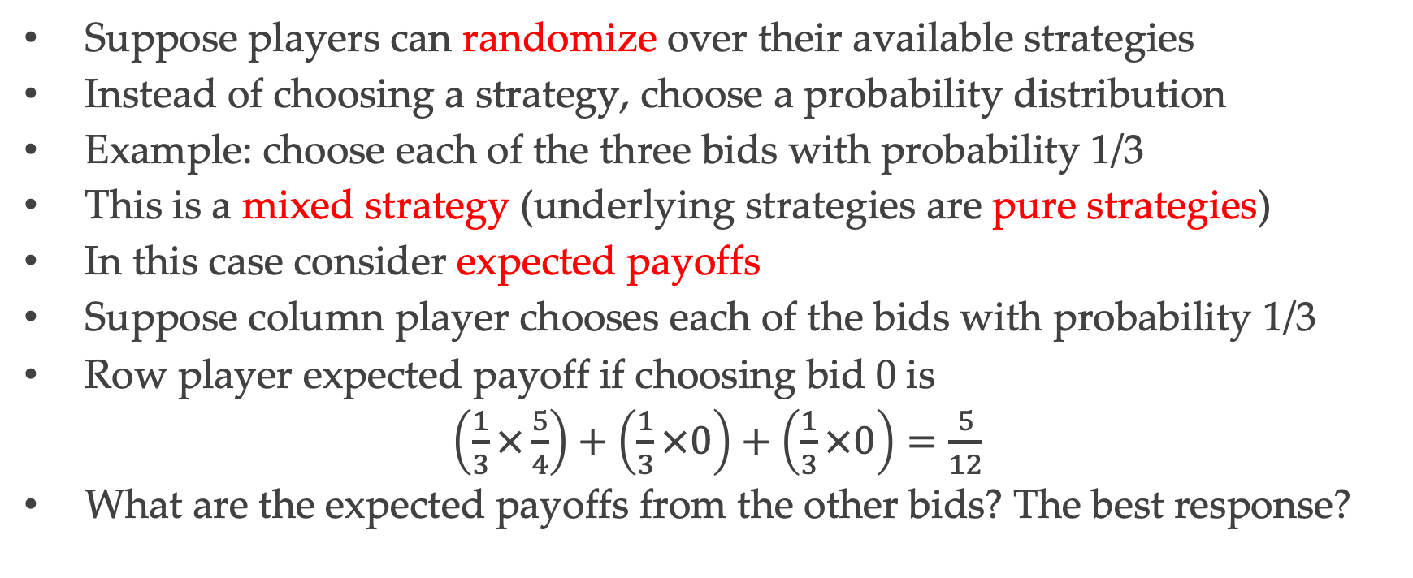
Mixed Strategies
Suppose players can randomize over their available strategies
Instead of choosing a strategy, choose a probability distribution
Example: choose each of the three bids with probability 1/3
This is a mixed strategy (underlying strategies are pure strategies)
In this case consider expected payoffs
Suppose column player chooses each of the bids with probability 1/3
Row player expected payoff if choosing bid 0 is
$\left(\frac{1}{3}×\frac{5}{4}\right)+\left(\frac{1}{3}×0\right)+\left(\frac{1}{3}×0\right)=\frac{5}{12}$
What are the expected payoffs from the other bids? The best response?

Slide 9
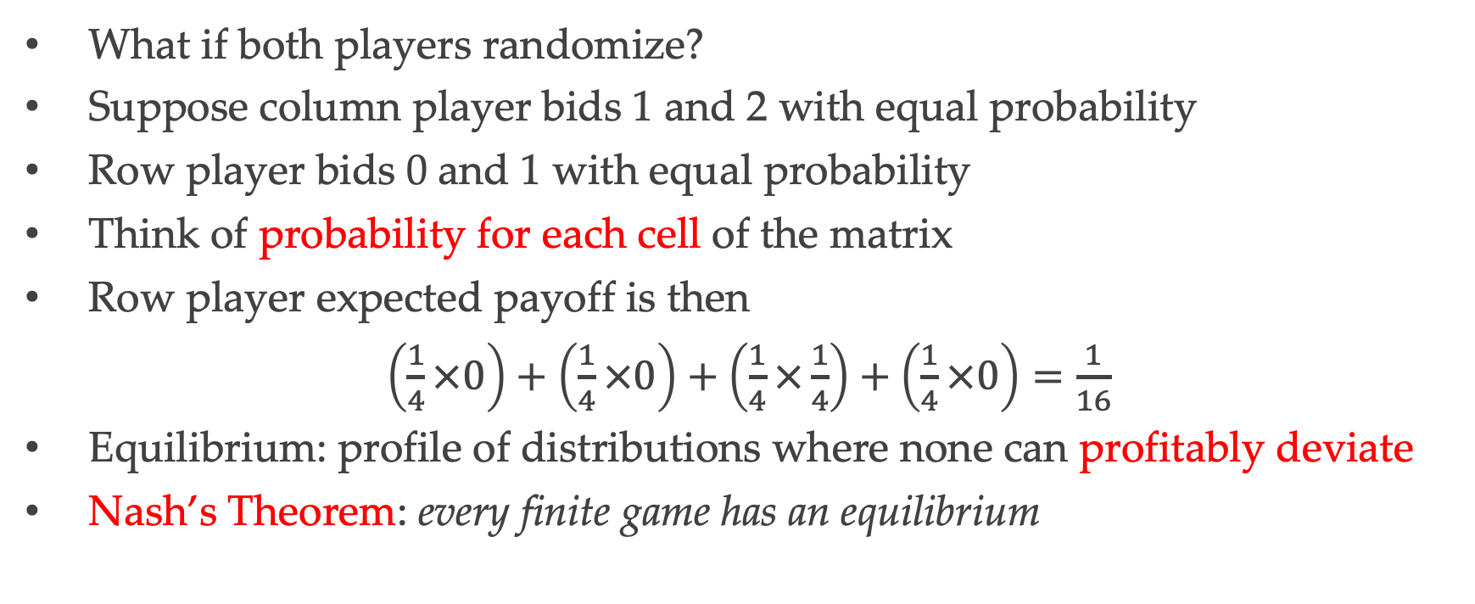
Equilibrium in Mixed Strategies
What if both players randomize?
Suppose column player bids 1 and 2 with equal probability
Row player bids 0 and 1 with equal probability
Think of probability for each cell of the matrix
Row player expected payoff is then
$\left(\frac{1}{4}×0\right)+\left(\frac{1}{4}×0\right)+\left(\frac{1}{4}×\frac{1}{4}\right)+\left(\frac{1}{4}×0\right)=\frac{1}{16}$
Equilibrium: profile of distributions where none can profitably deviate
Nash’s Theorem: every finite game has an equilibrium

Slide 10
Games with Many Players

Slide 11
Many Players
For most economic applications, need to consider many players
Firms in an industry, countries in the world, drivers on a road
Payoffs cannot be represented using matrices
But in some case, payoffs depend only on aggregate choice by others
Examples: greenhouse gas emissions, contributions to charity
Special case: a public goods game

Slide 12
Public Goods
Four farmers, each can contribute to irrigation maintenance
Private cost of contribution is $10
Each contribution benefits all farmers by $8 each (including contributor)
If I contribute, I lower my payoff by 2, raise other three payoffs by 8 each
Each players payoff depends on her choice and aggregate contribution
If two others contribute and so do I, what’s my payoff?
If one other contributes and I don’t, what’s my payoff?
Do players have a dominant strategy?
What is an equilibrium strategy profile?

Slide 13
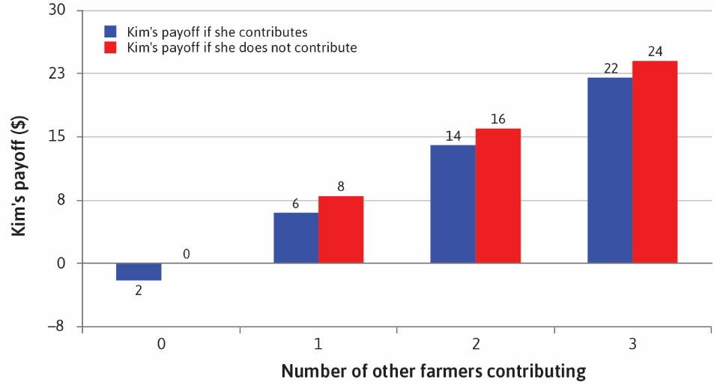

Slide 14
Games with Sequential Moves

Slide 15
Sequence of Moves
Many situations have moves and countermoves
A strategy in this case is a complete contingent plan of action
Chess: number of strategies exceeds number of atoms in universe
Ultimatum game: two players, proposer and responder
First mover proposes split of $100, either 50-50 or 80-20
Second mover accepts/ rejects; rejection yields 0 for both
How many strategies does the proposer have? And the responder?
What does the payoff matrix look like?
Such games can be depicted and analyzed using a game tree

Slide 16
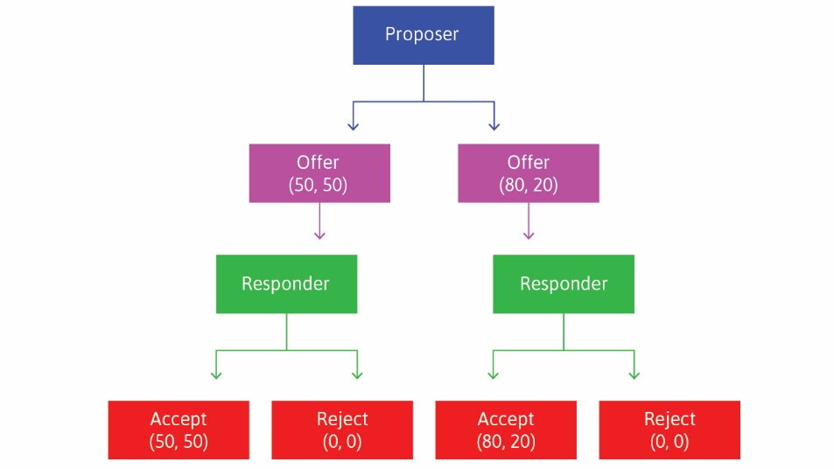

Slide 17
Backward Induction
Games with a sequence of moves can be solved by backward induction
Start with the last player to move, and determine her choice at each node
Then move back one step in the game tree, and repeat
So in the ultimatum game, responder chooses to accept at each node
Proposer anticipates this and offers an 80-20 split
This is an equilibrium: proposer offers 80-20, responder accepts all offers
Is this the only Nash equilibrium in the ultimatum game?

Slide 18
Self-Interest

Slide 19
Preferences
Does game theory assume that players are self-interested?
Not at all: payoffs just represent preferences over outcomes
Example: in public goods game, I may care about benefits to others
This changes payoff structure but we can still use equilibrium concept
Suppose each player places weight 0.5 on payoffs of others
So gain of $8 to another farmer adds $4 to my payoff
Now what does equilibrium look like?

Slide 20
Experiments
In laboratory experiments we can control monetary payoffs
But cannot observe what subjects really care about
In ultimatum game responder may be spiteful or care about reciprocity
In public goods game players may be altruistic to some degree
Experiments are a joint test of preferences and solution concepts
So experimental results need to be interpreted with care

